Slide 1
Elements as Objects
Tutorial #6

Slide 2
OBJECTIVE

Slide 3
Objective
This tutorial will teach you how to manipulate HTML elements through Javascript.

Slide 4
TEXTPLANATION

Slide 5
Textplanation
As was stated before, HTML is a front end language. Almost its entire purpose is to display information to a user. With CSS, you can dress it up all nice and sharp, but with Javascript, you can make it dance. The key to doing this is making connections between the HTML elements and the variables that represent them in Javascript.

Slide 6
Textplanation
You can make variables in Javascript that can represent your HTML elements. In fact, if you want your page to do anything, you have to do this.

Slide 7
Textplanation
The best thing about it is that the objects already exist. As soon as you load your browser, it reads your HTML and converts all of your tags into objects. You just need a way to grab them and store them in variables.

Slide 8
CONSTRUCTION

Slide 9
Construction
Create a folder somewhere on your drive and label it Elements as Objects.
Open up notepad++.
Save the empty file to your folder and name the file “index.html”.
All first pages on a website are called index.
As you go through the images of the construction, add to your code. You will see comments with explanations of what you are doing. Those comments will change with each slide. You should not type my comments into your code.

Slide 10
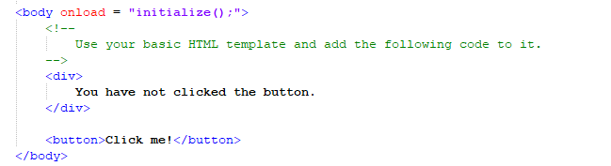
Construction

Slide 11
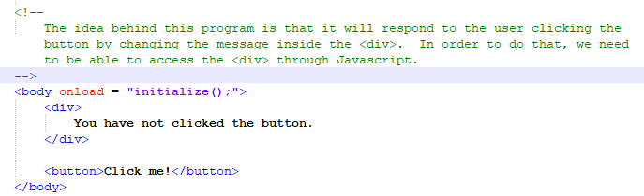
Construction

Slide 12
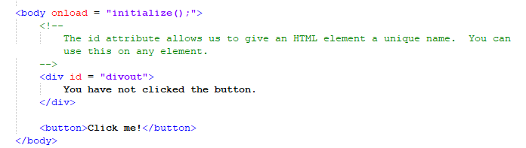
Construction

Slide 13
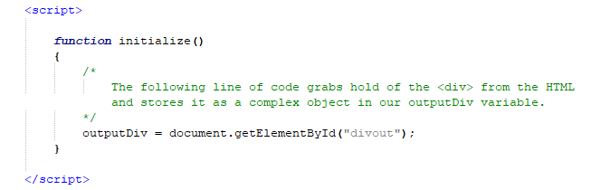
Construction

Slide 14
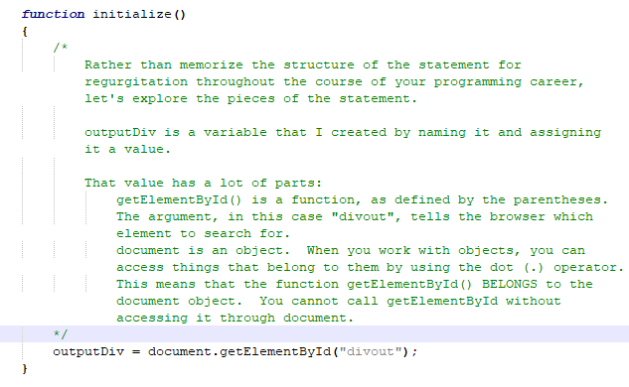
Construction

Slide 15
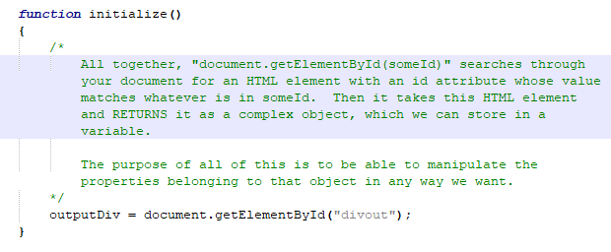
Construction

Slide 16

Construction

Slide 17
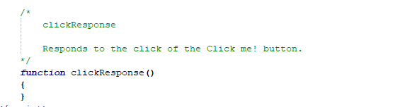
Construction

Slide 18
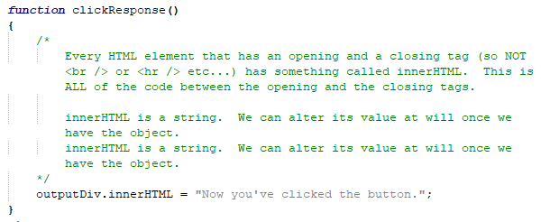
Construction

Slide 19
A DEEPER MEANING

Slide 20
A Deeper Meaning
This is you really using an object for the first time. Get used to it. Objects are everywhere. If you’re not clear on this relationship, experiment with it. Ask questions. Develop your understanding.

Slide 21
A Deeper Meaning
Don’t think of an object as code. Think of it, literally, as an object. You can hold it in your virtual hand and manipulate it in all kinds of ways. Our divOut = document.getElementById(“mydiv”); statement has a lot of layers, as do many Javascript statements. Having the patience to identify and peel away those layers is going to make you a programmer. Copying it from the internet and stuffing it into your code wherever you think it belongs is the wrong approach and you should squash that impulse here and now.

Slide 22
A Deeper Meaning
Your clues to understanding this statement are:
The assignment operator (=).
The dot (.).
The parentheses (()).

Slide 23
A Deeper Meaning
Let’s start with the assignment operator. You learned that an assignment operator has something on the left and something on the right. I want to reiterate that what goes on the left has to be a variable.

Slide 24
A Deeper Meaning
It has to be.

Slide 25
A Deeper Meaning
A variable.

Slide 26
A Deeper Meaning
Nothing else.

Slide 27
A Deeper Meaning
There are no exceptions.

Slide 28
A Deeper Meaning
None.

Slide 29
A Deeper Meaning
Not even one.

Slide 30
A Deeper Meaning
It must be a variable.

Slide 31
A Deeper Meaning
What goes on the left side of an assignment operator?

Slide 32
A Deeper Meaning
That’s right...a variable.

Slide 33
A Deeper Meaning
The right side of an assignment operator has a value. That value will go into the variable on the left side. That value can come in several different formats, like a straight up value, a calculation, or a function call that manufactures and returns a value. That’s what this is. A function call.

Slide 34
A Deeper Meaning
The function is getElementById(). The parentheses give that away. Those parentheses are used for arguments, which are values that get passed into the function so that it can do its job. I’ll talk about that in a minute.

Slide 35
A Deeper Meaning
The function is not document.getElementById(). The dot gives that away. The dot is a connector between an object and its properties and functions. That makes document and object and getElementById() one of its functions.

Slide 36
A Deeper Meaning
The argument inside the parentheses is the information the function needs in order to complete its task. If we’re telling it to get us an element using the id as defining criteria, then we’d better tell it which id we want it to look for.

Slide 37
A Deeper Meaning
Think about why the document as an object, has such a function. Our document object, which is represented by the <html> tag, is the grandparent of the whole page. All of our other elements are inside of it. Where else are we going to look for these elements?

Slide 38
FAQ

Slide 39
FAQ
I’ve looked online and seen code that uses “document.getElementById(“someid”).innerHTML = “Some String”. Why do we have to store it in a variable?
getElementById() is a function that looks through the entire page, finds the object with the matching id attribute, and returns it. When a function returns a value in this way, the call actually takes on the guise of that value. That means you can use it as that value. The function call is a one-and-done situation so, if you need that value later on, it’s worth storing it in a variable. If you only need it the one time, you can use it right there on the spot. Since getElementById() returns and object, you can use the function call as that object and access its innerHTML.

Slide 40
ACTIVITY

Slide 41
ASMD and the Countdown Revisited
ASMD uses a lot of alerts. Can you change it so that it doesn’t use any alerts?
Can you change The Countdown so that it doesn’t use any alerts, but still shows the countdown?

